Slide 1


Dart Programming Language Essentials:
Diving into Dart Syntax and Core Concepts
Notes:
Hey!everyone,welcome to our topic Dart Programming Language Essentials:diving into dart syntax and core concepts,In this we covering its syntax, data types, operators, and basic programming concepts.

Slide 2
Dart is a flexible programming language. It is open-source and used for creating web applications.
It is object-oriented, dynamically typed, and compiled ahead-of-time (AOT).
Introduction
Overview of Dart programming language and its significance
Dart is widely used for web development, mobile app development, and server-side programming.
Notes:
Now let’s discuss about Introduction of Dart .
What is Dart?
Dart is a relatively new language, but it has gained significant traction in the web development community due to its clean syntax, strong typing system, and powerful tooling.
Key Features:
Object-Oriented: Structures code using classes and objects, promoting modularity and organization.
Ahead-of-Time Compiled: Converts Dart code to efficient machine code, improving performance.

Slide 3
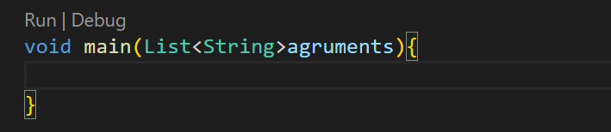
Dart Syntax
After the creation of the project, the project will start from the function main()
Programming must only start from that curly brackets({}).
Notes:
The main function returns void. Also, optional parameters List<String> may be used as arguments to the function. These arguments may be used in case we need to control our program from outside.

Slide 4

Dart Syntax Fundamentals
Variables in Dart are used to store data. They are declared using the 'var' keyword followed by the variable name.
Dart offers various data types, including numbers,strings, booleans,double and lists etc.
Operators perform operations on data;Dart has arithmetic operators ,Relational Operators AssignmentOperators,UnaryOperators , and logical operators.
Notes:
Understanding the basic building blocks of Dart syntax is essential for writing Dart programs. Variables, data types, and operators are fundamental concepts that form the foundation of Dart programming.

Slide 5
Date types
Data Type
Definition
Example
Int
Numbers
Int x = 5;
Double
Number with decimal value
double = 0.5;
String x = “Hello World”;
String
A sequence of characters
Booleans
Method of telling if an expression is true or false.
bool x = true; bool y = false;
List
An object to store more than one value
List pets = [
“cat”,”Dog”,”Bird”];
Map fruits = {
‘apple’ : 1,
‘banana’ : 2,
‘orange’ :3, }
Maps
An object to store more than one value
Notes:
String: A string represents string literals and is a sequence of characters.
Integer: represents non-fractional numbers (whole numbers).
Double: represents fractional numbers (floating-point numbers).
Boolean: A boolean represents true and false values.
List: A list is used to represent a collection of objects.
Map: A map is a dynamic collection that represents a set of values as key-value pairs.

Slide 6
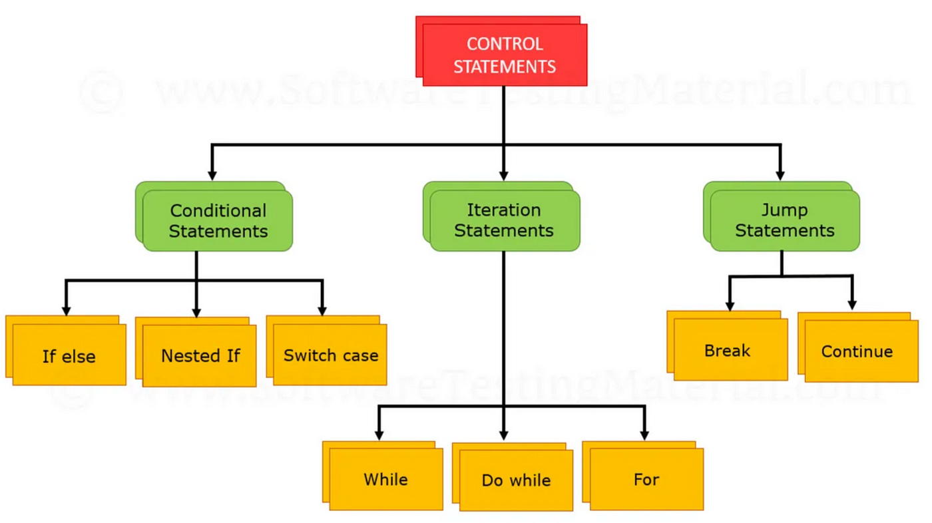
Control Statement
Notes:
The control statements or flow of control statements are used to control the flow of Dart program.
Control flow statement can be categorized mainly in three following ways:
Selection statements(Conditional statements)
Iteration statements
Jump statements
Dart provides following types of Decision-making statement
If Statement
If-else Statements
If else if Statement
Switch Case Statement
Dart provides following types of the Iteration statements
Dart for loop
Dart while loop
Dart do while loop
Dart provides following types of jump statements
Dart Break Statement
Dart Continue Statement

Slide 7
Selection Statement (Conditional)
Selection statement allow you to control the flow of the program during the runtime in the basis of outcome of an expression or by state of a variable.
Eg:
If a application needs to know whether a user is male or female by giving the user two choices ie male or female, after the user response how would the application will know?
There are two types of Selection(or condition) statements:
If ...else if..else..
Switch.. case..

Slide 8
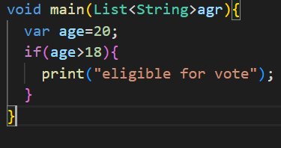
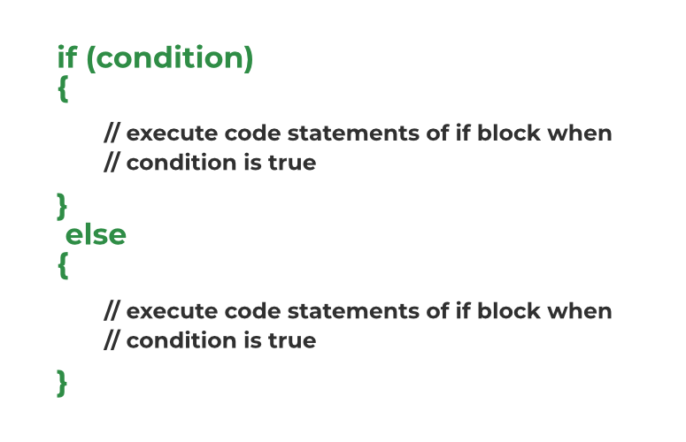
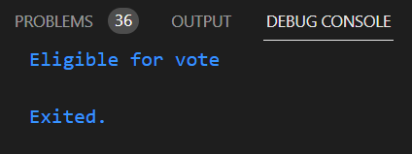
If
syntax:
Example:
Output:
Notes:
If: statement allows a block of code to be executed when the specified condition is true.

Slide 9
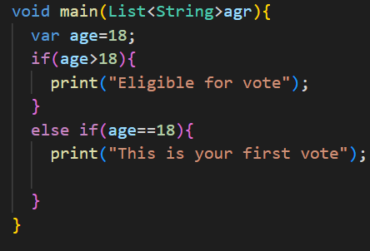
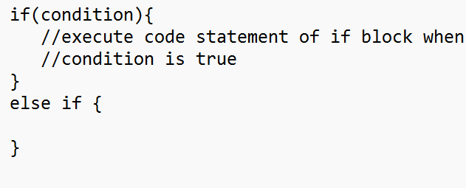
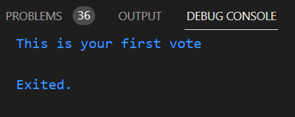
If...else if..
syntax:
Example:
else if: through this statement we can specify as much conditions as we want and execute the code only when the condition is true. (This statement will only checked or comes after if statement or else if.)
Output:
Notes:
else if: through this statement we can specify as much conditions as we want and execute the code only when the condition is true. (This statement will only checked or comes after if statement or else if.)

Slide 10
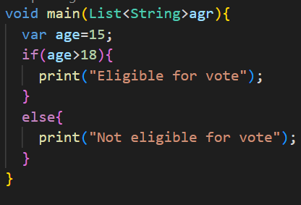
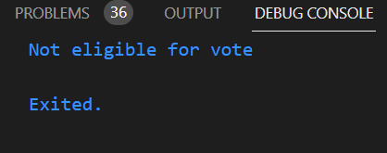
If ...else
syntax:
Example:
If: statement allows a block of code to be executed when the specified condition is true.
else: else statement code will only be executed when the conditions on if and else if got false.
Output:
Notes:
If: statement allows a block of code to be executed when the specified condition is true.
else: else statement code will only be executed when the conditions on if and else if got false.

Slide 11
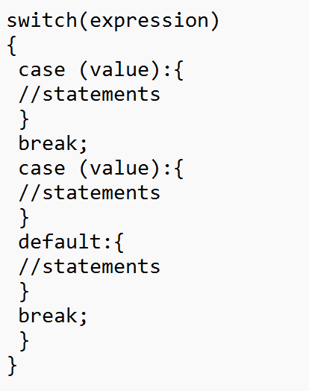
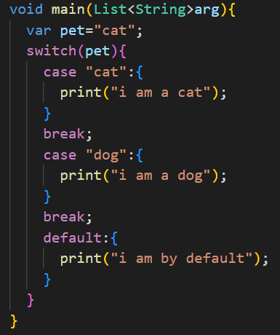
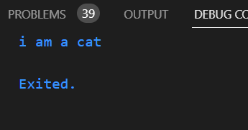
Switch...case
Switch case statement is simplified form if else statement, it helps to avoid long chain of if...else if...else statements.
syntax:
Example:
Output
Notes:
Switch case statement is simplified form nested if else statement, it helps to avoid long chain of if...else if...else statements.

Slide 12
Iteration statement (loop)
Iteration statements are used to execute the block of code repeatedly for a specified time or until it meets the specified condition.
There are three types of iteration statements:
while
do while
for
Notes:
Iteration statements are used to execute the block of code repeatedly for a specified time or until it meets the specified condition.
they are three types:
while
do while
for

Slide 13
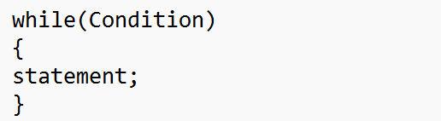
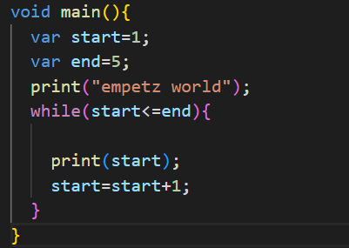
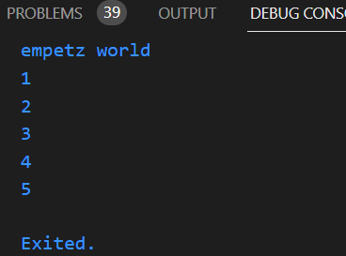
while
Syntax:
The while loop will execute a block of statements as long as the specified condition is true.
The while loop is useful, when the number of time we want to repeat the execution of the code is unknown beforehand.
Example:
Output:
Notes:
The while loop will execute a block of statements as long as the specified condition is true.
The while loop is useful, when the number of time we want to repeat the execution of the code is unknown beforehand.

Slide 14
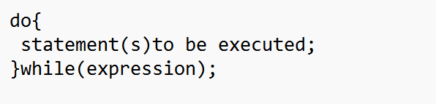
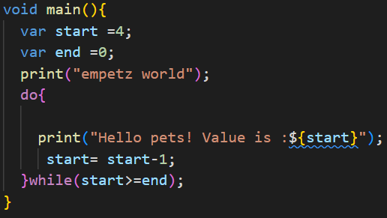
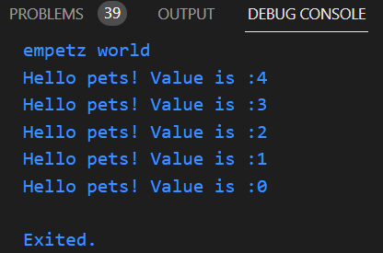
do while
Syntax:
The do while loop executes the code and checks whether the condition is true.The do while loop repeats as much as the condition is true.
The only difference between do while and while loop is that,
While loop check the condition and executes the code, do while executes the code and checks the condition.
Example:
Output:
Notes:
The do while loop executes the code and checks whether the condition is true.The do while loop repeats as much as the condition is true.
The only difference between do while and while loop is that,
While loop check the condition and executes the code, do while executes the code and checks the condition.

Slide 15
for
For loop is divided into two types
For
For in
Early, we discussed about storing more than one values in a variable(List),
So, how can we store and retrieve multiple values into that variable ?
So for that we use For loop.
Notes:
For loop is divided into two types
For
Foreach

Slide 16
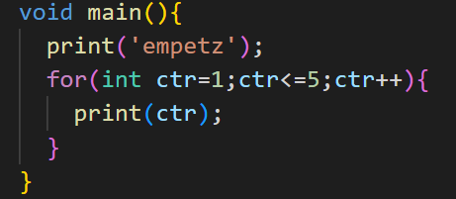
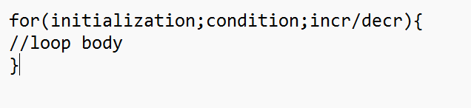
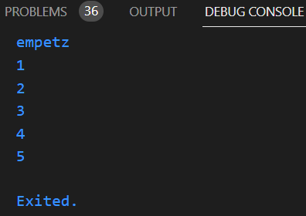
for
Example:
syntax:
Output:
Initialization: Starting of a loop
Condition: Ending of a loop
Incr/decr: Increment or decrement
Notes:
Initialization: Starting of a loop
Condition: Ending of a loop
Incr/decr: Increment or decrement

Slide 17
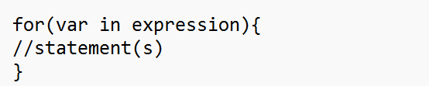
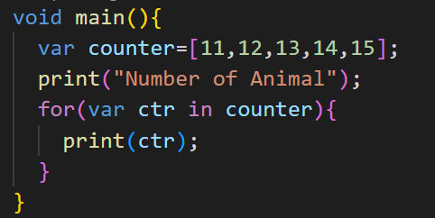
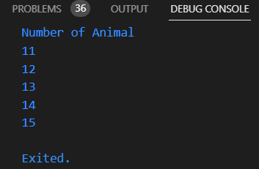
for...in
syntax:
For loop is only applied with the variable that is holding more that one value.
For … in loop will handle each value with the tasks we want to operate with that value.
For… in loop is as much same as For loop but has some difference.
Example:
Output:
Notes:
For loop is only applied with the variable that is holding more that one value.
For … in loop will handle each value with the tasks we want to operate with that value.
For… in loop is as much same as For loop but has some difference.

